Slide 1

Mario Karty
Mario Karty
Mario Karty
Goals
Mario Karty
Mario Karty
Mario Karty
Mario Karty
Mario Karty
Mario Karty

Slide 2

Mario Karty
Mario Karty
Mario Karty
Mario Karty
Mario Karty
Mario Karty
Challenges
Mario Karty
Mario Karty
Mario Karty

Slide 3

Mario Karty
Mario Karty
Mario Karty
Mario Karty
Mario Karty
Mario Karty
Achievements
Mario Karty
Mario Karty
Mario Karty

Slide 4


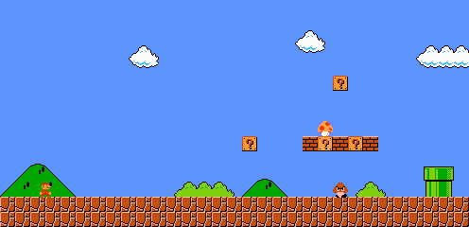

Position
Position
Position
2
3
4
nd
rd
th
10
10
10
10
Two is better than one.
Three is the best number of amigos.
May the fourth be with you.
Position
Position
Position
5
6
7
th
th
th
10
10
10
I’m not sure what I did,
but I’m pleading it.
Please don’t get 6th three times in a row, for all our sake.
Poor nine. Six is right to be scared.
Position
Position
Position
8
9
10
th
th
th
10
10
10
Eights aren’t crazy.
They are just misunderstood.
One does not simply say ‘nine’ without sounding German.
The perfect gift: ten lords a-leaping.

Slide 5
Position
11
th
10
Cutting it a bit close.

Slide 6
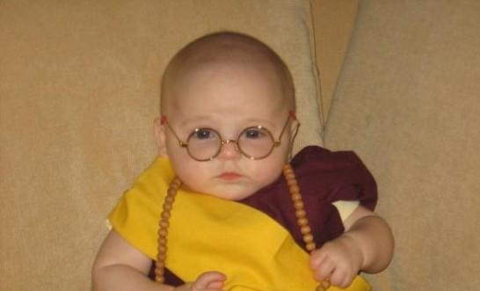

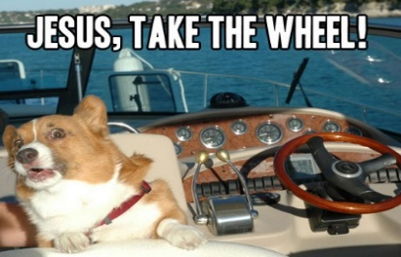
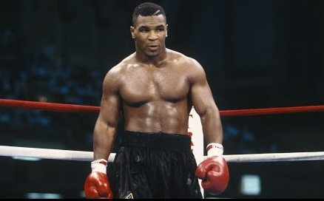
Pacifist
Pacifist
Pacifist
Look at font choices.
Current:
Montserrat
Super Mario 256
Use no items.
Use no items.
Use no items.
“In a gentle way, you can shake the world.”
13
“In a gentle way, you can shake the world.”
13
“In a gentle way, you can shake the world.”
13
Challenges
Driver’s Ed Teacher
Driver’s Ed Teacher
Driver’s Ed Teacher
Turn on driving assist and auto accelerate.
Do not steer at all.
Braking and Items
are allowed.
Turn on driving assist and auto accelerate.
Do not steer at all.
Braking and Items
are allowed.
Turn on driving assist and auto accelerate.
Do not steer at all.
Braking and Items
are allowed.
Picture Dimensions:
1.575 X 2.1
10
10
10
That’s not how this works!
That’s not how this works!
That’s not how this works!
Fighter
Fighter
Fighter
Hit 5 opponents
with any item.
Hit 5 opponents
with any item.
Hit 5 opponents
with any item.
“Everybody’s got plans…
until they get hit.”
15
“Everybody’s got plans…
until they get hit.”
15
“Everybody’s got plans…
until they get hit.”
15

Slide 7
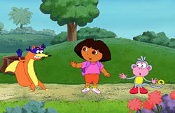
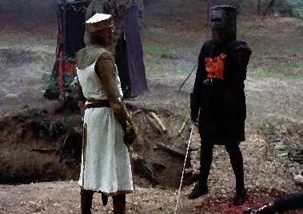
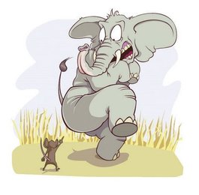

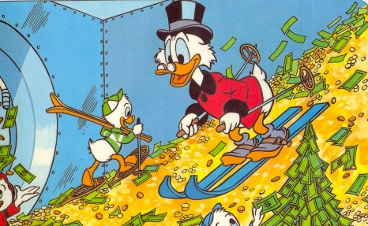
Don’t Stop Me Now
Don’t Stop Me Now
Flesh Wound
Look at font choices.
Current:
Montserrat
Super Mario 256
Block 2 items with
a Banana
Block 2 items with
a Banana
Run into 5 Shells
or Bananas.
Sniper, no sniping!
16
Sniper, no sniping!
16
‘Tis but a scratch!
14
Challenges
Irrational Fear
Irrational Fear
Flesh Wound
Do not touch a single item box.
Do not touch a single item box.
Run into 5 Shells
or Bananas.
Picture Dimensions:
1.575 X 2.1
18
18
14
Just try it.
It can’t be that bad.
Just try it.
It can’t be that bad.
‘Tis but a scratch!
Scrooge McDuck
Scrooge McDuck
Scrooge McDuck
Finish the race with
10 Coins.
Finish the race with
10 Coins.
Finish the race with
10 Coins.
The Golden Rule: He who has the gold makes the rules.
10
The Golden Rule: He who has the gold makes the rules.
10
The Golden Rule: He who has the gold makes the rules.
10

Slide 8
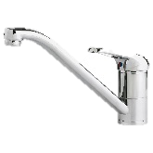

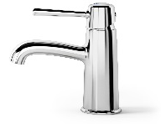
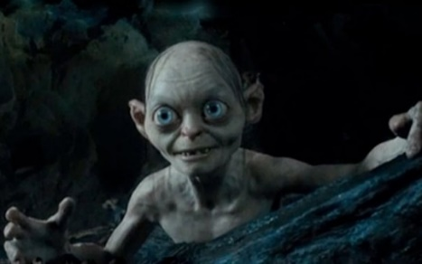
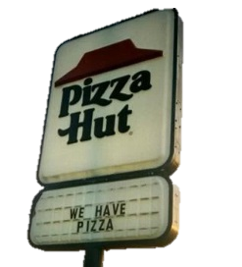
Triple Tap
Triple Tap
Triple Tap
Look at font choices.
Current:
Montserrat
Super Mario 256
Hit 3 opponents with
Green or Red Shells.
Hit 3 opponents with
Green or Red Shells.
Hit 3 opponents with
Green or Red Shells.
I’ll show you the power of
Tap water!
13
I’ll show you the power of
Tap water!
13
I’ll show you the power of
Tap water!
13
Challenges
Sabatoge!
Sabatoge!
Sabatoge!
Run into 3 Bananas
Run into 3 Bananas
Run into 3 Bananas
Picture Dimensions:
1.575 X 2.1
12
12
12
Searching for Bananas,
like Gollum for the ring.
Searching for Bananas,
like Gollum for the ring.
Searching for Bananas,
like Gollum for the ring.
Confusion
Confusion
Confusion
Drive with the
wheel backwards.
Drive with the
wheel backwards.
Drive with the
wheel backwards.
I can’t even deal with you right now.
14
I can’t even deal with you right now.
14
I can’t even deal with you right now.
14

Slide 9
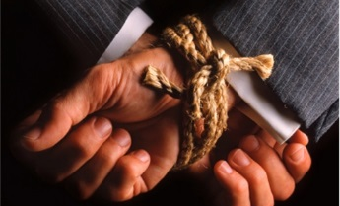
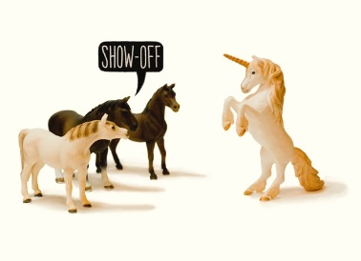
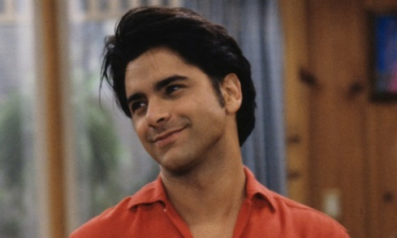
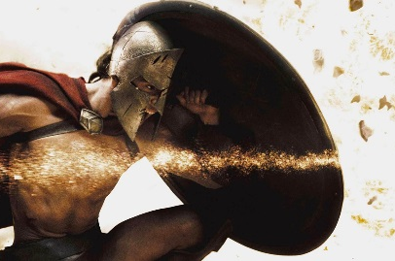
Guilty
Guilty
Guilty
Look at font choices.
Current:
Montserrat
Super Mario 256
Drive with the wheel behind your back.
Drive with the wheel behind your back.
Drive with the wheel behind your back.
Before the proof,
I was innocent.
14
Before the proof,
I was innocent.
14
Before the proof,
I was innocent.
14
Challenges
Fast and Furious
Fast and Furious
Mercy
Drive with one hand.
Drive with one hand.
The opponent to your left draws 2 Challenges and gives one to you,
discarding the other.
Picture Dimensions:
1.575 X 2.1
12
12
3
Scientifically proven to
make you go faster.
Scientifically proven to
make you go faster.
Please, I beg you!
Shield
Shield
Shield
Block an item with
a Banana.
Block an item with
a Banana.
Block an item with
a Banana.
A day may come when
I get stopped by a shell,
but it is not this day!
12
A day may come when
I get stopped by a shell,
but it is not this day!
12
A day may come when
I get stopped by a shell,
but it is not this day!
12

Slide 10
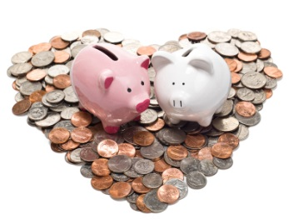
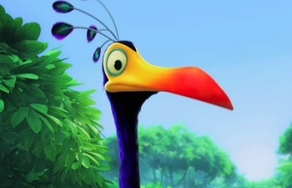
Frugal
Frugal
Frugal
Look at font choices.
Current:
Montserrat
Super Mario 256
Finish the race with exactly
1 Coin
Finish the race with exactly
1 Coin
Finish the race with exactly
1 Coin
A penny saved is
a penny earned.
11
A penny saved is
a penny earned.
11
A penny saved is
a penny earned.
11
Challenges
Snipe
Snipe
Snipe
Hit 5 opponents with
Green or Red Shells.
Hit 5 opponents with
Green or Red Shells.
Hit 5 opponents with
Green or Red Shells.
Picture Dimensions:
1.575 X 2.1
15
15
15
I found the snipe!
I found the snipe!
I found the snipe!

Slide 11

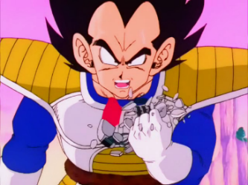
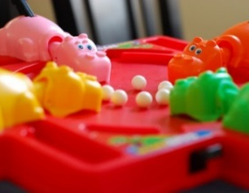


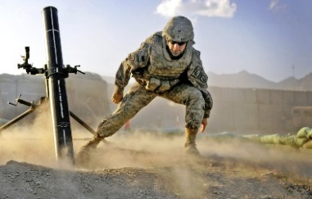
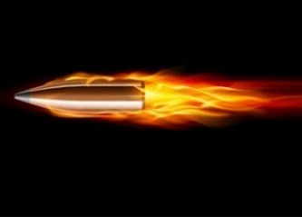
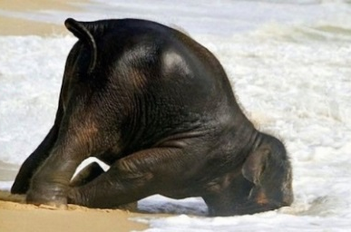
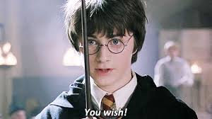
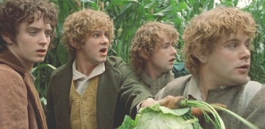
Archenemy
Over 9000!
Hungry Hippos
Hit one opponent
at least 3 times with a single
Fire Flower.
Without falling off the track,
use a Golden Mushroom
constantly until it expires.
Bite 3 different opponents with a single Piranha Plant.
4
2
6
Is he mostly dead, or all dead?
What’s his power level?
You could almost say he was
“hungry hungry”.
Superstar
Mortar Man
Speeding Bullet
Achievements
Hit 3 different opponents while protected by a single Star power.
Launch a Bob-omb forward and have it explode an opponent in front of you.
Pass 3 opponents while riding a
single Bullet Bill.
4
3
3
The crowd loves you!
That really worked?
Can’t compete with that.
Clumsy
Impedimenta
Mushrooms!
In one race, hit your own
Green Shell 3 times.
Throw a Banana forward to hit an opponent who is in front of you.
In one race, find and use
3 Mushrooms that have fallen
onto the course.
2
6
4
Should have read the manual first.
Wizards are good at spelling.
You’ve been into Farmer Maggot’s crop!

